Slide 1
Application Layer
The Application Layer is the topmost layer in the OSI (Open Systems Interconnection) model and is responsible for providing network services directly to end-users and applications. It acts as the interface between the underlying network protocols and the software applications that utilize network communication.
The Application Layer is crucial for enabling user applications to communicate over a network. It defines the protocols and standards for data exchange and provides services that allow applications to interact with the network seamlessly.
By handling data representation, session management, and protocol-specific functions, the Application Layer ensures that end-users can effectively use networked applications.
Key Responsibilities of the Application Layer
Network Services to Applications:
The Application Layer provides network services to end-user applications by enabling communication and data exchange over a network. It facilitates interactions between software applications and network protocols.

Slide 2
Application Layer
DNS (Domain Name System): Used for translating domain names into IP addresses.
Data Representation:
It handles data representation and encoding, ensuring that data is formatted in a way that the receiving application can understand. This may involve converting data into formats like JSON, XML, or HTML.
Session Management:
Manages the session between applications, including establishing, maintaining, and terminating connections. This includes ensuring that data exchanges are coherent and organized.
Error Handling and Data Integrity:
Provides mechanisms for error detection and correction to ensure reliable communication between applications. This includes handling retransmissions and managing data integrity.
User Interface Interaction:
The Application Layer interfaces with the end-user, allowing users to interact with networked applications through graphical user interfaces (GUIs) or command-line interfaces.

Slide 3
Application Layer
Examples of Application Layer Protocols :
HTTP (Hypertext Transfer Protocol):
Used for web browsing and transferring web pages from servers to clients.
FTP (File Transfer Protocol):
Used for transferring files between a client and a server.
SMTP (Simple Mail Transfer Protocol):
Used for sending emails from clients to mail servers.
DNS (Domain Name System):
Used for resolving domain names to IP addresses.
Telnet and SSH (Secure Shell):
Used for remote login and command execution on networked systems.
SMTP (Simple Mail Transfer Protocol): Used for sending emails.
POP3/IMAP (Post Office Protocol 3/Internet Message Access Protocol): Used for retrieving emails from a server.

Slide 4
World Wide Web
The World Wide Web is an architectural framework for accessing linked documents spread out over millions of machines all over the Internet.
In 10 years, it went from being a way to distribute high-energy physics data to the application that millions of people think of as being “The Internet.''
Its enormous popularity stems from the fact that it has a colorful graphical interface that is easy for beginners to use, and it provides an enormous wealth of information on almost every conceivable subject, from aardvarks to Zulus.
The Web (also known as WWW) began in 1989 at CERN, the European center for nuclear research.
The initial proposal for a web of linked documents came from CERN physicist Tim Berners-Lee in March 1989. The first (text-based) prototype was operational 18 months later.
In December 1991, a public demonstration was given at the Hypertext '91 conference in San Antonio, Texas.
In 1994, CERN and M.I.T. signed an agreement setting up the World Wide Web Consortium (sometimes abbreviated as W3C), an organization devoted to further developing the Web, standardizing protocols, and encouraging interoperability between sites.

Slide 5
World Wide Web
The Web consists of a vast, worldwide collection of documents or Web pages, often just called pages for short. Each page may contain links to other pages anywhere in the world. Users can follow a link by clicking on it, which then takes them to the page pointed to.
This process can be repeated indefinitely. The idea of having one page point to another, now called hypertext, was invented by a visionary M.I.T. professor of electrical engineering, Vannevar Bush, in 1945, long before the Internet was invented.
Pages are viewed with a program called a browser, of which Internet Explorer and Netscape Navigator are two popular ones. The browser fetches the page requested, interprets the text and formatting commands on it, and displays the page, properly formatted, on the screen.
An example is given in Fig. (a). Like many Web pages, this one starts with a title, contains some information, and ends with the e-mail address of the page's maintainer.
Strings of text that are links to other pages, called hyperlinks, are often highlighted, by underlining, displaying them in a special color, or both. To follow a link, the user places the mouse cursor on the highlighted area, which causes the cursor to change, and clicks on it.

Slide 6
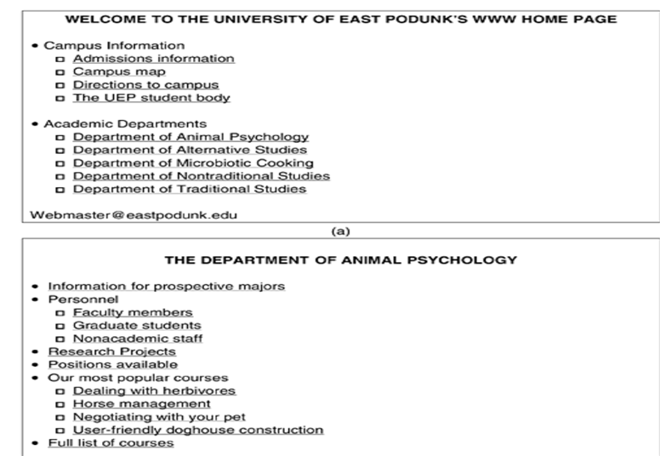
Architectural- World Wide Web
Although non-graphical browsers, such as Lynx, exist, they are not as popular as graphical browsers, so Voice-based browsers are also being developed.
A Web page.
The page reached by clicking on
Department of Animal Psychology

Slide 7
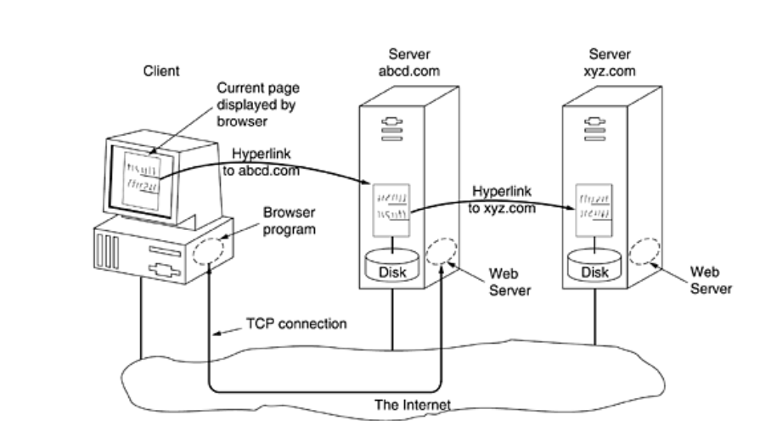
Architectural- World Wide Web
The basic model of how the Web works is shown in Figure. Here the browser is displaying a Web page on the client machine.
When the user clicks on a line of text that is linked to a page on the abcd.com server, the browser follows the hyperlink by sending a message to the abcd.com server asking it for the page.
When the page arrives, it is displayed. If this page contains a hyperlink to a page on the xyz.com server that is clicked on, the browser then sends a request to that machine for the page, and so on indefinitely.

Slide 8
Architectural- World Wide Web
Client Side:
In essence, a browser is a program that can display a Web page and catch mouse clicks to items on the displayed page.
When an item is selected, the browser follows the hyperlink and fetches the page selected. Therefore, the embedded hyperlink needs a way to name any other page on the Web.
Pages are named using URLs (Uniform Resource Locators). A typical URL is
http://www.abcd.com/products.html
A URL has three parts: the name of the protocol (http), the DNS name of the machine where the page is located (www.abcd.com), and (usually) the name of the file containing the page (products.html).
When a user clicks on a hyperlink, the browser carries out a series of steps in order to fetch the page pointed to. Suppose that a user is browsing the Web and finds a link on Internet telephony that points to ITU's home page, which is http://www.itu.org/home/index.html.

Slide 9
Architectural- World Wide Web
1. The browser determines the URL (by seeing what was selected).
2. The browser asks DNS for the IP address of www.itu.org.
3. DNS replies with 156.106.192.32.
4. The browser makes a TCP connection to port 80 on 156.106.192.32.
5. It then sends over a request asking for file /home/index.html.
6. The www.itu.org server sends the file /home/index.html.
7. The TCP connection is released.
8. The browser displays all the text in /home/index.html.
9. The browser fetches and displays all images in this file.
Many browsers display which step they are currently executing in a status line at the bottom of the screen. In this way, when the performance is poor, the user can see if it is due to DNS not responding, the server not responding, or simply network congestion during page transmission.
To be able to display the new page (or any page), the browse has to understand its format.
To allow all browsers to understand all Web pages, Web pages are written in a standardized language called HTML, which describes Web pages.

Slide 10
Architectural- World Wide Web
Not all pages contain HTML. A page may consist of a formatted document in PDF format, an icon in GIF format, a photograph in JPEG format, a song in MP3 format, a video in MPEG format, or any one of hundreds of other file types.
Since standard HTML pages may link to any of these, the browser has a problem when it encounters a page it cannot interpret.
Rather than making the browsers larger and larger by building in interpreters for a rapidly growing collection of file types, most browsers have chosen a more general solution.
When a server returns a page, it also returns some additional information about the page. This information includes the MIME type of the page.
Pages of type text/html are just displayed directly, as are pages in a few other built-in types.
If the MIME type is not one of the built-in ones, the browser consults its table of MIME types to tell it how to display the page. This table associates a MIME type with a viewer.

Slide 11
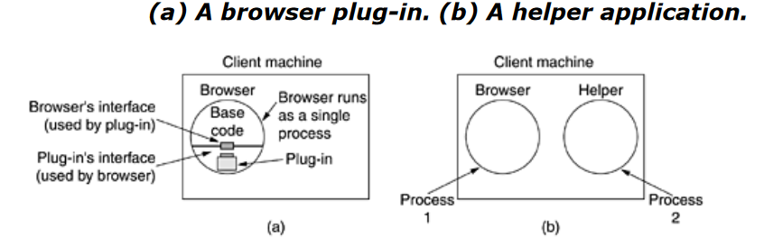
Architectural- World Wide Web
There are two possibilities: plug-ins and helper applications. A plug-in is a code module that the browser fetches from a special directory on the disk and installs as an extension to itself, as illustrated in Figure a.
Plug-ins run inside the browser, they have access to the current page and can modify its appearance. After the plug-in has done its job (usually after the user has moved to a different Web page), the plug-in is removed from the browser's memory.
Each browser has a set of procedures that all plug-ins must implement so the browser can call the plug-in.
For example, there is typically a procedure the browser's base code calls to supply the plug-in with data to display. This set of procedures is the plug-in's interface and is browser specific.

Slide 12
Architectural- World Wide Web
The other way to extend a browser is to use a helper application. This is a complete program, running as a separate process. It is illustrated in Fig.(b).
Since the helper is a separate program, it offers no interface to the browser and makes no use of browser services. Instead, it usually just accepts the name of a scratch file where the content file has been stored, opens the file, and displays the contents.
Typically, helpers are large programs that exist independently of the browser, such as Adobe's Acrobat Reader for displaying PDF files or Microsoft Word. Some programs (such as Acrobat) have a plug-in that invokes the helper itself.
Many helper applications use the MIME type application. A considerable number of subtypes have been defined, for example, application/pdf for PDF files and application/msword for Word files. In this way, a URL can point directly to a PDF or Word file, and when the user clicks on it.
Acrobat or Word is automatically started and handed the name of a scratch file containing the content to be displayed. Consequently, browsers can be configured to handle a virtually unlimited number of document types with no changes to the browser.
Modern Web servers are often configured with hundreds of type/subtype combinations and new ones are often added every time a new program is installed.

Slide 13
Architectural- World Wide Web
Browsers can also open local files, rather than fetching them from remote Web servers. Since local files do not have MIME types, the browser needs some way to determine which plug-in or helper to use for types other than its built-in types such as text/html and image/jpeg.
To handle local files, helpers can be associated with a file extension as well as with a MIME type.
With the standard configuration, opening foo.pdf will open it in Acrobat and opening bar.doc will open it in Word. Some browsers use the MIME type, the file extension, and even information taken from the file itself to guess the MIME type.
In particular, Internet Explorer relies more heavily on the file extension than on the MIME type when it can.
MIME types and extensions they are prepared to handle to allow the user to select the appropriate ones and thus not overwrite existing associations by accident.

Slide 14
Architectural- World Wide Web
Server Side
When the user types in a URL or clicks on a line of hypertext, the browser parses the URL and interprets the part between http:// and the next slash as a DNS name to look up.
Armed with the IP address of the server, the browser establishes a TCP connection to port 80 on that server. Then it sends over a command containing the rest of the URL, which is the name of a file on that server. The server then returns the file for the browser to display.
To a first approximation, a Web server is similar to the server. That server, like a real Web server, is given the name of a file to look up and return. In both cases, the steps that the server performs in its main loop are:
Accept a TCP connection from a client (a browser).
Get the name of the file requested.
Get the file (from disk).
Return the file to the client.
Release the TCP connection.
Modern Web servers have more features, but in essence, this is what a Web server does.

Slide 15
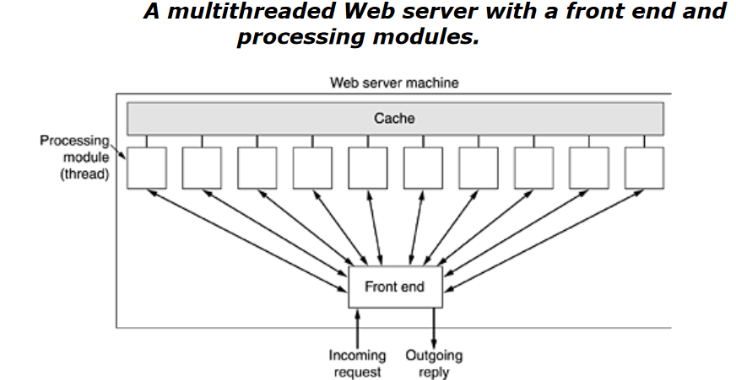
Architectural- World Wide Web
The server consists of a front-end module that accepts all incoming requests and k processing modules, as shown in Figure.
The k + 1 threads all belong to the same process so the processing modules all have access to the cache within the process' address space.
When a request comes in, the front end accepts it and builds a short record describing it. It then hands the record to one of the processing modules. Thee front end is eliminated and each processing module tries to acquire its own requests, but a locking protocol is then required to prevent conflicts.

Slide 16
Architectural- World Wide Web
The processing module first checks the cache to see if the file needed is there. If so, it updates the record to include a pointer to the file in the record. If it is not there, the processing module starts a disk operation to read it into the cache
When the file comes in from the disk, it is put in the cache and also sent back to the client.
The advantage of this scheme is that while one or more processing modules are blocked waiting for a disk operation to complete (and thus consuming no CPU time), other modules can be actively working on other requests.
Of course, to get any real improvement over the single-threaded model, it is necessary to have multiple disks, so more than one disk can be busy at the same time. With k processing modules and k disks, the throughput can be as much as k times higher than with a single-threaded server and one disk.
A single-threaded server and k disks could also gain a factor of k, but the code and administration are far more complicated since normal blocking READ system calls cannot be used to access the disk.
With a multithreaded server, they can be used since then a READ blocks only the thread that made the call, not the entire process. Modern Web servers do more than just accept file names and return files. In fact, the actual processing of each request can get quite complicated.

Slide 17
Architectural- World Wide Web
A processing module performs a series of steps. The front end passes each incoming request to the first available module, which then carries it out using some subset of the following steps, depending on which ones are needed for that particular request.
1. Resolve the name of the Web page requested.
2. Authenticate the client.
3. Perform access control on the client.
4. Perform access control on the Web page.
5. Check the cache.
6. Fetch the requested page from disk.
7. Determine the MIME type to include in the response.
8. Take care of miscellaneous odds and ends.
9. Return the reply to the client.
10. Make an entry in the server log.

Slide 18
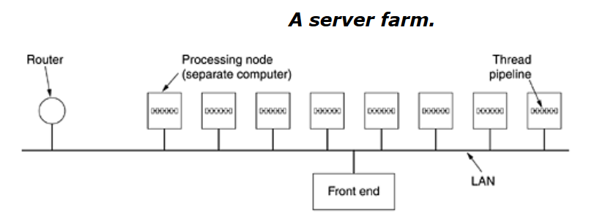
Architectural- World Wide Web
If too many requests come in each second, the CPU will not be able to handle the processing load, no matter how many disks are used in parallel. The solution is to add more nodes (computers), possibly with replicated disks to avoid having the disks become the next bottleneck.
This leads to the server farm model of Figure. A front end still accepts incoming requests but sprays them over multiple CPUs rather than multiple threads to reduce the load on each computer.
The individual machines may themselves be multithreaded and pipelined as before.

Slide 19
Architectural- World Wide Web
One problem with server farms is that there is no longer a shared cache because each processing node has its own memory—unless an expensive shared-memory multiprocessor is used.
One way to counter this performance loss is to have a front end keep track of where it sends each request and send subsequent requests for the same page to the same node.
Doing this makes each node a specialist in certain pages so that cache space is not wasted by having every file in every cache.
Another problem with server farms is that the client's TCP connection terminates at the front end, so the reply must go through the front end.
Where the incoming request (1) and outgoing reply (4) both pass through the front end. Sometimes a trick, called TCP handoff, is used to get around this problem.
With this trick, the TCP end point is passed to the processing node so it can reply directly to the client, shown as (3) in Figure b. This handoff is done in a way that is transparent to the client.

Slide 20
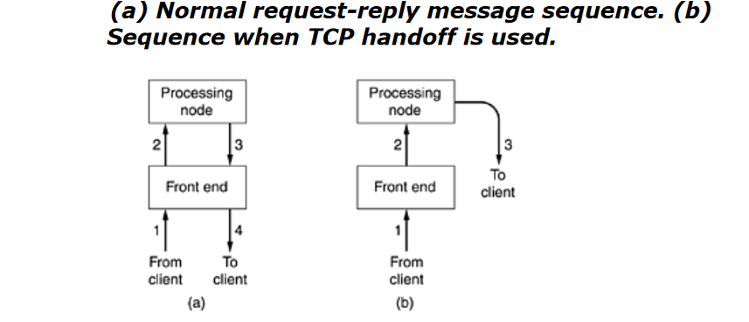
Architectural- World Wide Web

Slide 21
URLs—Uniform Resource Locators
A URL (Uniform Resource Locator) is a reference or address used to access resources on the internet. It provides a way to locate and retrieve resources such as web pages, images, files, and services.
URLs are a critical component of the web and are used by web browsers and other software to request and interact with online resources.
Structure of a URL
A typical URL consists of several components, each serving a specific purpose:
Scheme (Protocol):
Indicates the protocol to be used to access the resource. Common schemes include:
http (Hypertext Transfer Protocol)
https (HTTP Secure, used for secure communication)
ftp (File Transfer Protocol)
mailto (for email addresses)
Example: https
Host (Domain):
Specifies the domain name or IP address of the server hosting the resource.
Example: www.example.com

Slide 22
URLs—Uniform Resource Locators
Port:
Optional. Specifies the port number on the server to connect to. If omitted, default ports are used (e.g., 80 for HTTP, 443 for HTTPS).
Example: :8080
Path:
Indicates the specific location of the resource on the server, usually represented as a path in the directory structure.
Example: /path/to/resource
Query String:
Optional. Contains parameters for the resource, typically used to pass data to the server. It starts with a ? and includes key-value pairs separated by &.
Example: ?key1=value1&key2=value2
Fragment:
Optional. Points to a specific section or element within the resource, often used for navigating to a part of a webpage. It starts with a #.
Example: #section1

Slide 23
URLs—Uniform Resource Locators
Usage of URLs
Web Browsing:
URLs are used by web browsers to locate and display web pages.
APIs:
URLs are used to make requests to web APIs, allowing interaction with web services and data retrieval.
Email:
mailto: URLs are used to create email links that open the default email client with a pre-filled recipient address.
File Transfers:
ftp: URLs are used for transferring files between clients and servers.
URL is a standardized way of addressing and accessing resources on the internet.
It provides a complete path to a resource by specifying the protocol, domain, port, path, query parameters, and optionally, a fragment. Understanding URLs is essential for navigating the web, interacting with web services, and managing online resources.

Slide 24
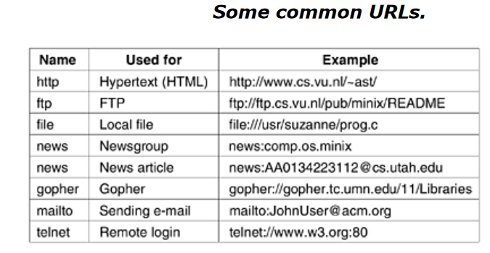
URLs—Uniform Resource Locators

Slide 25
Statelessness and Cookies
Statelessness and cookies are fundamental concepts in web development and web application design, addressing how web servers and clients manage state and sessions.
Statelessness
Statelessness refers to the principle that each request from a client to a server should contain all the information needed to understand and process the request. This concept is central to the HTTP protocol, which is inherently stateless.
Key Points of Statelessness:
No Retained State:
Each HTTP request is independent; the server does not retain information about previous requests. This means that the server does not maintain any session or state information between requests.
Request Completeness:
Every request must contain all the necessary information for the server to fulfill the request. For example, if a user submits a form, all relevant data must be included in that submission.
Scalability:
Statelessness simplifies server design and scaling because servers do not need to manage or store state information across requests. This allows servers to handle a higher number of requests more efficiently.
Challenges:
Statelessness can be challenging for applications that need to maintain user sessions or track user-specific data across multiple requests.

Slide 26
Statelessness and Cookies
Cookies
Cookies are a mechanism used to maintain state between stateless HTTP requests. They allow a server to store small amounts of data on a client's browser and retrieve it on subsequent requests.
Key Points About Cookies:
Definition:
A cookie is a small piece of data sent from the server and stored on the client's browser. Cookies are used to remember information about the user or their preferences between different requests.
Components of a Cookie:
Name: The name of the cookie.
Value: The value assigned to the cookie name.
Domain: The domain for which the cookie is valid.
Path: The path within the domain where the cookie is accessible.
Expiration Date: The date when the cookie expires. If not set, the cookie will be a session cookie and expire when the browser is closed.
Secure: Indicates whether the cookie should be sent only over HTTPS connections.
HttpOnly: Indicates whether the cookie should be accessible only via HTTP requests and not by JavaScript running on the page (helps prevent cross-site scripting attacks).

Slide 27
Statelessness and Cookies
Setting and Retrieving Cookies:
Setting Cookies:
http
Set-Cookie: sessionId=abc123; expires=Wed, 21 Aug 2024 00:00:00 GMT; path=/; domain=example.com
Retrieving Cookies: When the client makes a subsequent request to the server, the browser automatically sends the cookie data in the Cookie header:
http
Cookie: sessionId=abc123
4. Use Cases:
Session Management: Cookies are commonly used to maintain user sessions, such as keeping users logged in between visits.
Personalization: Cookies can store user preferences and settings to customize the user experience.
Tracking: Cookies can track user activity across different sessions and websites for analytics and advertising purposes.

Slide 28
Statelessness and Cookies
Interaction Between Statelessness and Cookies
Maintaining State: While HTTP itself is stateless, cookies provide a way to maintain state across requests by storing and sending data that helps the server identify users or sessions.
Session Management: Cookies are often used to manage sessions in a stateless protocol. When a user logs in, the server sets a session cookie, which is sent back with each request to maintain the user's session.
Summary
Statelessness refers to the characteristic of HTTP where each request is independent and does not retain state information. This simplicity enhances scalability but poses challenges for applications requiring user state management.
Cookies provide a method for maintaining state by storing small amounts of data on the client-side and sending it with subsequent requests. This mechanism helps overcome the limitations of statelessness by enabling session management, personalization, and tracking.

Slide 29
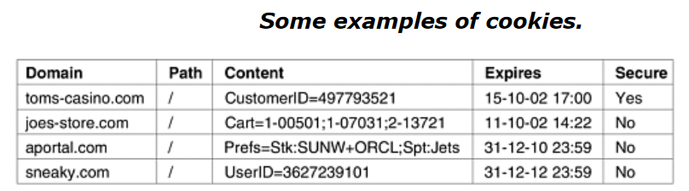
Statelessness and Cookies
A cookie may contain up to five fields, as shown in Figure. The Domain tells where the cookie came from. Browsers are supposed to check that servers are not lying about their domain.
Each domain may store no more than 20 cookies per client. The Path is a path in the server's directory structure that identifies which parts of the server's file tree may use the cookie. It is often /, which means the whole tree.
The Content field takes the form name = value. Both name and value can be anything the server wants. This field is where the cookie's content is stored.
The Expires field specifies when the cookie expires. If this field is absent, the browser discards the cookie when it exits. Such a cookie is called a non-persistent cookie. If a time and date are supplied, the cookie is said to be persistent and is kept until it expires.

